Slide 1

Internet Marketing
9-<number>

Slide 2
The focus of this chapter is on several learning objectives
The many offerings of online shopping
Various ways to do Internet marketing
The steps to take in launching a marketing campaign
How to attract and track customers on the Internet
The importance of customer service
The basics of CRM and how it contributes to adding value to e-commerce
9-<number>

Slide 3
The Pros of Online Shopping
Choice
  have many options regarding product, pricing
Vast selection
  can be displayed, reviewed, compared at no cost in time or money
Quick comparison
  in terms of price, quality, shipping terms
9-<number>

Slide 4
The Cons of Online Shopping
Certain buying decisions require information that can best be found in traditional stores
  personal items like perfume , clothing
  Products/service that require in-store help/training before use
  Product delivery problems for large item like furnitures
9-<number>

Slide 5
Justifying an Internet Business
Establish presence
Serve customers
Heighten public awareness
Share time-sensitive information
Sell goods
Answer important questions
9-<number>

Slide 6
Justifying an Internet Business (Cont’d)
Market at the international level
Serve the local market
Market specialized products
Reach the youth market
9-<number>

Slide 7
Internet Marketing Techniques
Banner is advertising with links to a merchant’s Web site
Pull marketing is passive Internet marketing, where the user takes the initiative requesting specific information from the Web site
In Push marketing technology the Web site “pushes” the information at the customer, irrespective of his or her interest (spam mail)
Registering with search engines and directories
  google adsense
9-<number>

Slide 8
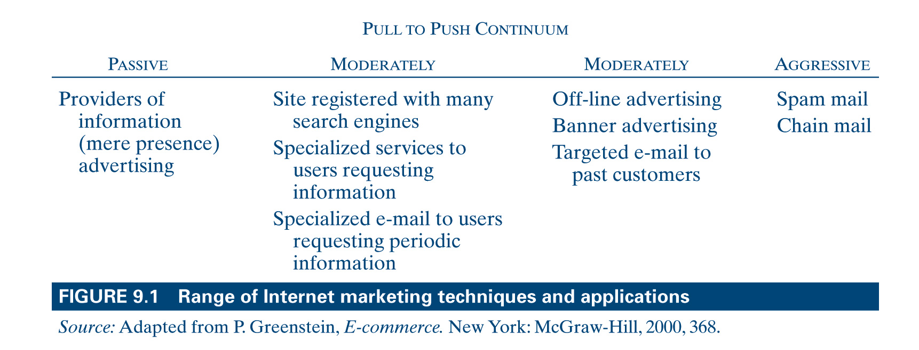
Range of Internet Marketing
Techniques and Applications
9-<number>

Slide 9
Aggressive Internet Marketing
Aggressive marketing is a marketing technique where the Web site seeks out potential customers; push technology
Spamming is sending out millions of e-mails to recipients who never asked for them
  Invasion of privacy
  Costing corporations millions each year to fight unwanted messages
9-<number>

Slide 10
Pop-up Advertising
An advertisement that “pops up” in a new browser window regardless of the user’s wish to open such a new window
  Among the most common forms of online marketing
  Push marketing
  “Kick-through” advertising
  “Mouse trapping”
Among the most controversial forms of online marketing
A major source of revenue
Ethical implications to pop-up ads?
9-<number>

Slide 11
Permission Marketing
Marketers ask permission before they send advertisements to prospective customers
  marketer sends advertisement that the consumer is interested in
9-<number>

Slide 12
The E-cycle of Internet Marketing
The Business Plan is a written document that identifies a merchant’s business goals and how to achieve them. The content of a business plan includes:
  Mission : what are your business trying to achieve
  Product: what are the product? what is unique?
  Competition: there identity, establishment, unique feature
  Target audience: do they use internet at home or office, use email, news group etc.
  Marketing: who to reach customer, advertising media
  Sales plan: what sales method? distribution Chanel, pricing, fulfillment method?
  Operation : equipment, location, size of facility, no. of employee, support team , supplier
  Technology: hardware/software, ISP and their charging
9-<number>

Slide 13
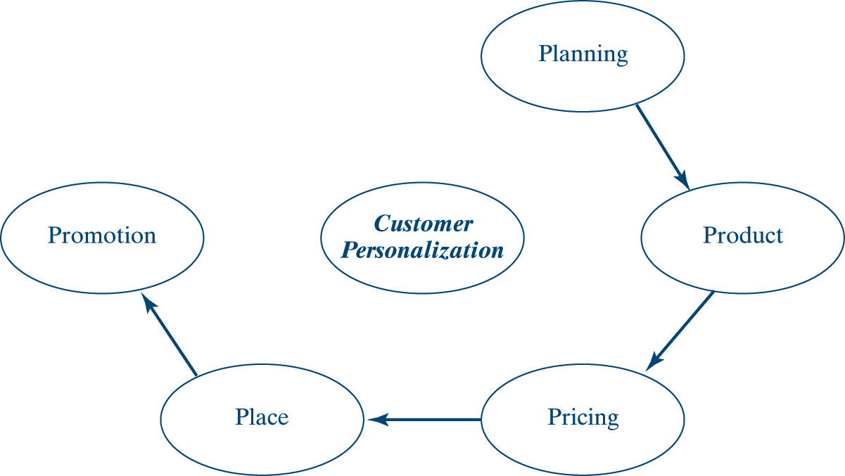
The E-cycle of Internet Marketing (Cont’d)
9-<number>

Slide 14
The E-cycle of Internet Marketing (Cont’d)
The Product
  may be physical goods or service
  the emphasis is on viability, quality, reliability, dependability and integrity
  quality product means fewer headache
  finding unique feature is importent
Pricing
  web based pricing strategy differs with the merchant, the market and type of customer
  free service to develop a community
  frequent purchase plan
  web only special plan
  ask for price to customer
9-<number>

Slide 15
The E-cycle of Internet Marketing (Cont’d)
Place
  exchange of info. between business and delivery company ( FedEx)
  Internet itself is a delivery channel for digital goods like software, music, books, news
  drawback is tapping or theft of digital data
Promotion
  Promotion of a product gets the attention of prospective customers
  The AIDA principle
    Attention: web site quality, ease of use, attractive banner
    Interest: quick response time, attractive display of product
    Desire: detailed info of product, good pricing, attractive offer
    Action: initiates fulfillment phase, form should be easier to fill up.
9-<number>

Slide 16
The E-cycle of Internet Marketing (Cont’d)
9-<number>

Slide 17
Examples of the “Best” Web Sites
http://www.CNET.com
http://www.Shutterfly.com
http://www.ESPN.com
http://www.NationalGeographic.com
http://www.Evite.com
http://www.Amazon.com
http://www.ZDNet.com
http://www.EBay.com
http://www.CNN.com
http://www.e-trade.com
9-<number>

Slide 18
Examples of the “Worst” Web Sites
http://www.modestapparelchristianclothinglydiaofpurpledressescustomsewing.com
http://www.2atoms.com/comedy/worstoftheweb/blount.htm
http://www.live-shot.com
http://www.whoisjesusreally.com/english/default.htm
For more examples see:
http://www.worstoftheweb.com
9-<number>

Slide 19
New Format Brand Ads
Skyscrapers
Bulky boxes
Buttons and “Big Impressions”
Pop-up Ads
E-mail
9-<number>

Slide 20
Personalization - the fifth “P”
A technique that combines product and promotion for customers to receive information customized to their needs
  Technically detailed descriptions are presented to the level of the user’s knowledge
  Product presentations are customized to suit the user’s interests
  The user’s expectations are met regarding the amount of relevant information
9-<number>

Slide 21
Important Personalization Rules
Prevent resistance to personalization
Consider any source of information
State preferences of users through forms or similar procedures
Focus on privacy in every way possible
Make an effort to learn from every move
Sell the goodness of personalization
make sure there is no delay in a personalization environment
9-<number>

Slide 22
Important Personalization Rules (Cont’d)
Jump-start a personalization relationship by posing the user a set of questions.
Sell the goodness of personalization.
Make life easier for users to tell you what they want and what they hate.
Make sure there is no delay in a personalization environment.
9-<number>

Slide 23
Marketing Implications
Power shift has occurred from the merchant to the consumer
Consumer can access any information on virtually any topic
Common-sense rules:
  Content: Don’t bore your customers with unnecessary content.
  Dynamic and attractive sites
  Brands: Web site should be most important brand
  Get to the point: Conciseness, clarity, and ease of navigation
  Promotion
  Online events
  Free giveaways
  Consistency
9-<number>

Slide 24
How to Market Presence
Promoting your site on your site
Promoting your site on the web
  Search engine is a program that uses a logic search to find sites based on a combination of keywords
  Directory is an organized listing with specific categories such as yellow and white pages in a telephone directory
  Spider is a program that explores the Web, collects keyword information, and stores it on a huge database
Promoting your site on the Internet
  Use email to contact registered customers
  Advertise through news groups and mailing lists
  Use mobile marketing and wireless “yellow” pages
9-<number>

Slide 25
Guidelines for Attracting Customers to your Site
Keep the site content current so visitors continue to return for news
Offer free information or products
Implement a cross-selling strategy
  for e.g. present customer with other books of the same author
Ensure easy and quick navigation
  use customer profiling or personalization
  any piece of information should be accessed with no more than 3 clicks
9-<number>

Slide 26
Guidelines for Attracting Customers to your Site
Introduce event marketing
  sell on special event like Christmas
Enlist affiliates
  use other sites to promote their user to encourage buying on your site.
9-<number>

Slide 27
Trends in Internet Use
Useful to help predict buying behavior
The online population is younger, more educated, and wealthier than the overall U.S. population.
Most online consumers are white.
More than 40 percent reported spending more than 20 hours per week browsing on the Web from home.
Most regular use for the Internet is for work and at work.
The Internet is used regularly at home to read news and for entertainment.
9-<number>

Slide 28
Personalization
First step in personalization is identification
Ways to add personalization to a Web site
  keywords
  collaborative filtering
  rule-based personalization
9-<number>

Slide 29
Tracking Customers
Goal is to observe and analysis visitors movement to ensure as many visitor as possible is converted to purchaser.
Gathering Web Data to Track Customers
  Log files
  Forms
  Cookies
  Clickstream data analysis
9-<number>

Slide 30
Gathering Web Data to Track Customers
Log files are files on the Web server that keep track of
  domain types,
  time of access,
  keywords used
  search engines used
Forms
Cookies
Clickstream data analysis
  visitors’ clicks, which leave footprints representing their behavior
  Pinpoint a host of customer behaviors
  used to make site more user friendly
9-<number>

Slide 31
Common Clickstream Data
Where a visitor first landed on the site
How a visitor got to the site
Number and sequence of pages viewed
Number and cost of each product purchased
Length of time the visitor stayed on each page and on the entire site
Total cost of each visit
Point on the site where the visitor clicked away
9-<number>

Slide 32
The Business Case for E-Intelligence
Integrates e-business operations into the traditional business environment
Helps business users make informed decisions based on accurate and consistent e-business information
Assists e-business applications in profiling and segmenting e-business customers to personalize the actual Web pages displayed
Extends the business intelligence environment outside of the corporate firewall to trading partners
Extends the business intelligence environment outside of the corporate firewall to key corporate clients
Links together e-business applications with business intelligence and collaborate processing applications
9-<number>

Slide 33
Customer Service
Automation removes the human contact between buyer and merchant
“Don’t annoy the customer”
  customer should be keep informed about his order status
  must be minimum wait time over the phone
  order should be
  there should be a follow up process
defective product can spell disaster
  Order taking is the easy part
  Fulfillment is where the merchant promotes or destroys customer satisfaction
9-<number>

Slide 34
Main Goals of CRM
Better customer service and customer revenues
More efficient call center
Faster closing of deals by sales staff
More effective cross selling of products
Simplified market and sales processes
Discovering new customers and personalizing relationships to improve profitability and customer satisfaction
9-<number>

Slide 35
Overall Goal of CRM
Identify what truly matters for the customer
  First, notice what customers are doing
  Second, remember what customers have done over time
  Third, learn from what is remembered
  Fourth, act on what has been learned
9-<number>

Slide 36
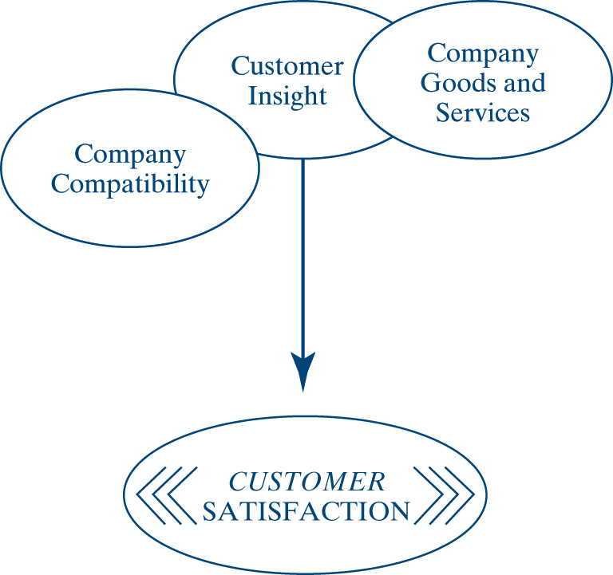
Interrelated Elements of Customer Satisfaction
9-<number>

Slide 37

Developing and Understanding Relationship with Customers
9-<number>

Slide 38
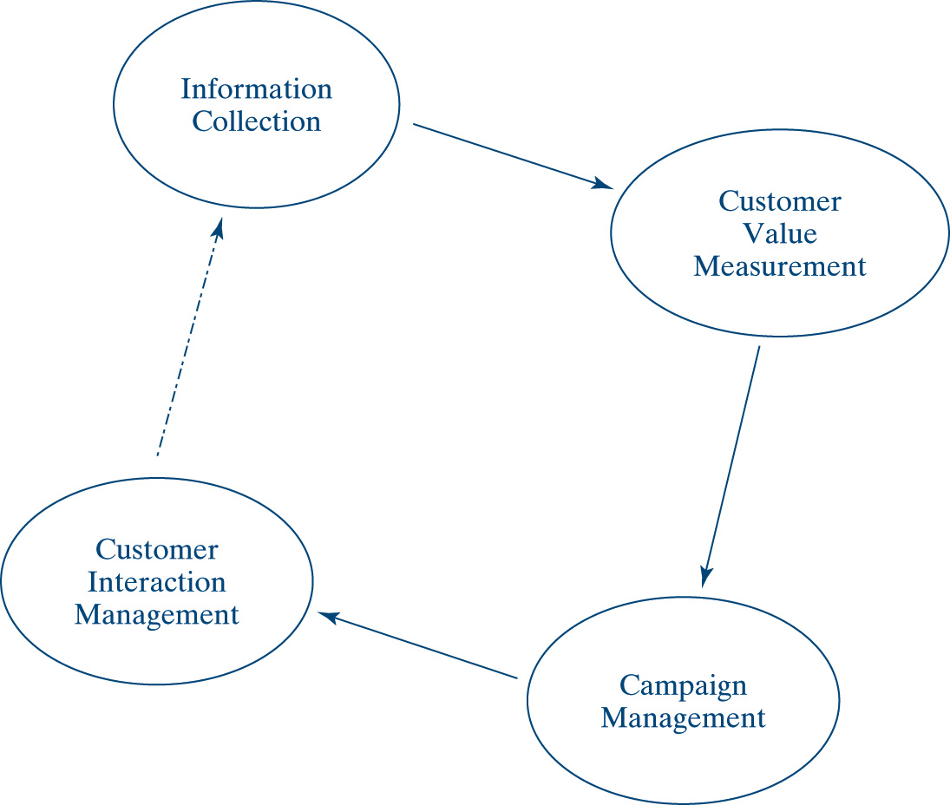
CRM-integrating Critical Processing
9-<number>

Slide 39
Managing Implications
An important implication for management is return on investment
The future of the Internet and e-commerce lies in customer tracking and personalization
Internet marketing allows firms to communicate with customers around the clock
Companies should reconsider their approach to customer support
E-commerce without e-service can be suicidal for a business
Successful Internet marketing means high-level executive involvement
9-<number>

Slide 40
Chapter Summary
Marketing is the process of planning and implementing the conception, pricing, advertising, and distribution of goods and services to meet the demands of the market
Three factors make online shopping attractive:
  quick sorting through choices
  vast selection of products
  quick comparison of products
Online shopping has some drawbacks
9-<number>

Slide 41
Chapter Summary (Cont’d)
Internet provides a continuum of marketing techniques
Internet marketing is made up of an e-cycle that begins with planning followed by the four P’s
One marketing implication behind the power shift from merchant to consumer is a unique marketing strategy that follows rules that make sense
To promote a site on the Web, it must be available to search engines and directories
9-<number>

Slide 42
Chapter Summary (Cont’d)
Attracting customers to a site involves:
  keeping site content current
  offering free information or products
  implementing cross-selling strategies to assist visitors in making a final decision
  quick and easy navigation
  Introducing event marketing
  Enlisting affiliates
9-<number>

Slide 43
Chapter Summary (Cont’d)
The first step in personalization is customer identification
Successful Internet marketing means:
  High-level executive involvement
  Thinking about a new way of selling and delivering merchandise
  Finding what it takes to implement the company’s e-business vision
9-<number>

